Slide 1
Selected Topics in Computational Intelligence I
Session 6
Optimization Problem

Slide 2
Agenda
One Max Problem
Traveling Salesman Problem
Travelling tournament Problem
Job Shop Scheduling
Clustering

Slide 3
One-Max Problem
Objective: maximize the number of 1s in a string of length 5, composed only of 1s and 0s
⇒ population size = 4
chromosome length = 5
fitness function = no. of genes that are 1

Slide 4
Example Population
individual 1:
chromosome = 11001
fitness = 3
individual 2:
chromosome = 00001
fitness = 1
individual 3:
chromosome = 11111
fitness = 5
individual 4:
chromosome = 01110
fitness = 3

Slide 5
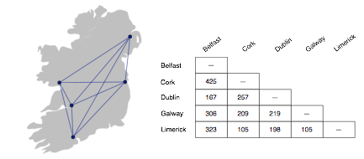
Traveling Salesman Problem
Suppose you decide to ride a bicycle around Ireland
you will start in Dublin
the goal is to visit Cork, Galway, Limerick, and Belfast before returning to Dublin
What is the best itinerary?
how can you minimize the number of kilometers yet make sure you visit all the cities?

Slide 6
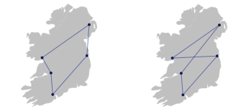
Optimal Tour
If there are only 5 cities it’s not too hard to figure out the optimal tour
the shortest path is most likely a “loop”
any path that crosses over itself will be longer than a path that travels in a big circle

Slide 7
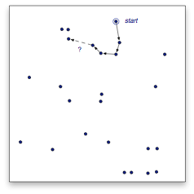
Increasing the Number of Cities
As we add cities to our tour, however, it is much harder to figure out the optimal tour
a simple strategy of going to the closest city does not always lead to the shortest tour
this example has 25 cities
after visiting 4 cities, where would you go next?
Hint: going to this city does not lead to the shortest tour...

Slide 8
Exhaustive Search
One way to find the optimal tour is to consider all possible paths
The lab module for this chapter includes a class named Map that represents cities and distances between them
If m is a Map object, this Ruby statement will consider all possible tours and save the one with the shortest distance:
>> m.each_tour { |t| best = t if t.cost < best.cost }
The method named each_tour is just like the each method that iterates over a list
it iterates over all possible tours
even though we don’t have an actual list of tours, this iteration is a type of search
computer scientists call it an exhaustive search since all combinations are tried

Slide 9
Too Many Tours
There is a problem with the exhaustive search strategy
the number of possible tours of a map with n cities is (n − 1)! / 2
n! (pronounced “n factorial”) is the product n × (n − 1) × (n − 2) ... × 2 × 1
The number of tours grows incredibly quickly as we add cities to the map
#cities | #tours
5 | 12
6 | 60
7 | 360
8 | 2,520
9 | 20,160
10 | 181,440
The number of tours for 25 cities:
310,224,200,866,619,719,680,000

Slide 10
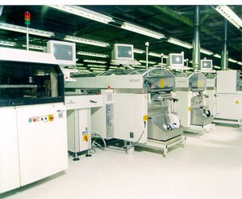
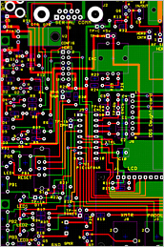
Real-Life Applications
It’s not likely anyone would want to plan a bike trip to 25 cities
But the solution of several important “real world” problems is the same as finding a tour of a large number of cities
transportation: school bus routes, service calls, delivering meals, ...
manufacturing: an industrial robot that drills holes in printed circuit boards
VLSI (microchip) layout
communication: planning new telecommunication networks
For many of these problems n (the number of “cities”) can be 1,000 or more

Slide 11
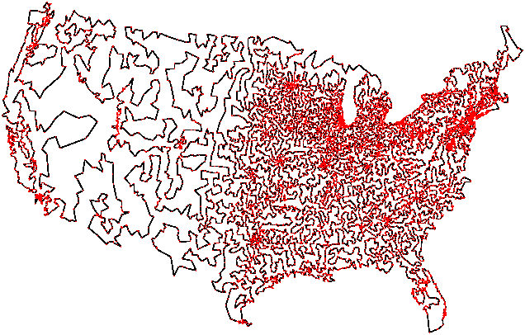
The Traveling Salesman
Computer scientists call the problem of finding an optimal path between n points the traveling salesman problem (TSP)
The TSP is a famous problem
first posed by Irish mathematician W. R. Hamilton in the 19th century
intensely studied in operations research and other areas since 1930
Required 5 “CPU-years”
This tour of 13,500 US cities was generated by an advanced algorithm that used several “tricks” to limit the number of possible tours
http://www.tsp.gatech.edu/

Slide 12
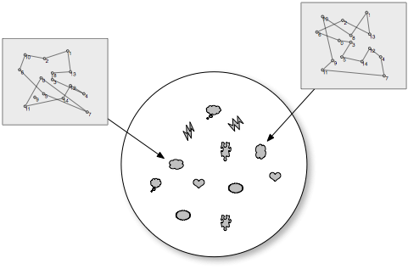
Genetic Algorithm
One way to approach the TSP is to use an evolutionary algorithm
the type of algorithm we will explore is known as a genetic algorithm
Imagine we have a Petri dish with several hundred different tours
In Ruby, each tour will be an separate object, each with a different possible path

Slide 13
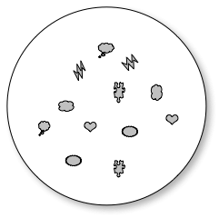
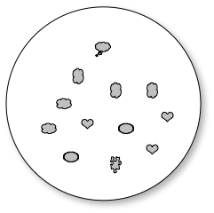

Our program will repeatedly evaluate all the tours in the “dish”
throw out the longer tours
replace them with copies of the better tours
each copy is slightly different than the tour it was copied from
But after enough rounds of “evolution” a good tour will emerge
This approach is not guaranteed to find the optimal tour

Slide 14
Travelling Tournament Problem (TTP)
TTP is Sports Schedulling Combinatorial Optimization Problem
Objective is to create a double robin tournament with minimal travel distance
TTP takes in n (even) teams and distance matric
Each Team must play once every round
Each team i play one home and one way against with every other team, j

Slide 15
Travelling Tournament Problem (TTP)
No repeat : prevent any team from playing another team consecutive rounds
At most :restricts number of consecutive home and away games to 3
Number of round is 2(n-1), whereas n/2 games are played in every round.
Related to real of Scheduling Major League Baseball
Benchmark : http://mat.gsia.cmu.edu/TOURN

Slide 16
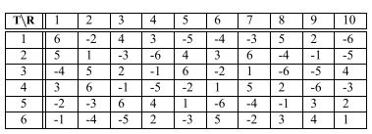
Travelling Tournament Problem (TTP)
Sample
Team 1 successively plays against teams T 6 at home, T 2 away, T 4 at home, T 3 at home, T 5 away, T 4 away, T 3 away, T 5 at home, T 2 at home, T 6 away.
The travel cost of team T 1 is
d 12 + d 21 + d 15 + d 54 + d 43 + d 31 + d 16 + d 61 .

Slide 17
Job Shop Schedulling (JSS)
Purpose is finding a sequential allocation of competing resources that optimizes a particular objective function
The problem JSS consists of :A finite set J of n jobs
Each Job Ji must be processed on every machine and consists of a chain mi operation Oi1, Oi2,…..Oim, which have to be scheduled in a pre-determined given order.
Oij is the j-th operation of job i
A Machine, Mx, perform operation in duration processing time, τij , without interuption and preemption

Slide 18
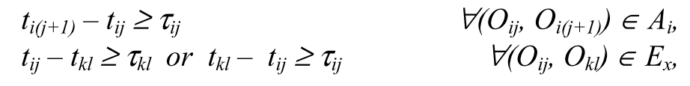
Job Shop Schedulling
Each machine can process only one job and each job can be processed by only one machine at a time.
The longest duration in which all operation of all jobs are completed is referred to as makespan (Cmax).
Ai is set ordered pair of operations constrained by precedence relation for job Ji
For each machineMx, the set Ex describes the set of all pairs of operation to be performed on machine.

Slide 19
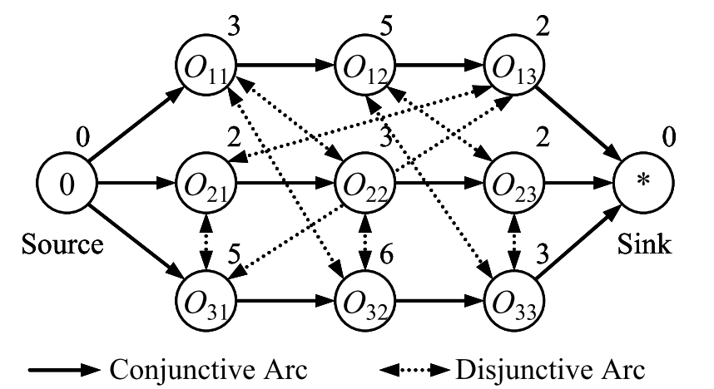
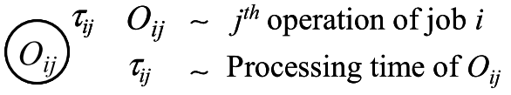
Example JSS with 3 x 3
Disjunctive Graph Representation of 3 x 3 instance
The set of operations on each machine is given by:
M 1 = {O11 , O22 , O32 }, M 2 = {O12 , O23 , O33 } and M 3 = {O 13 , O21 , O31 }

Slide 20
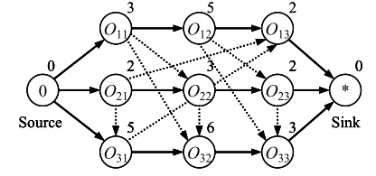
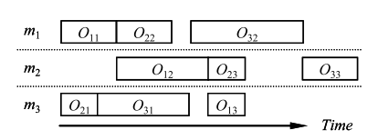
Feasible Solution
Makespan is 16 (O21+O31+O32+O33)

Slide 21
Clustering Problem
Ch. 16
Clustering: the process of grouping a set of objects into classes of similar objects
Documents within a cluster should be similar.
Documents from different clusters should be dissimilar.
The commonest form of unsupervised learning
Unsupervised learning = learning from raw data, as opposed to supervised data where a classification of examples is given
A common and important task that finds many applications in IR and other places

Slide 22
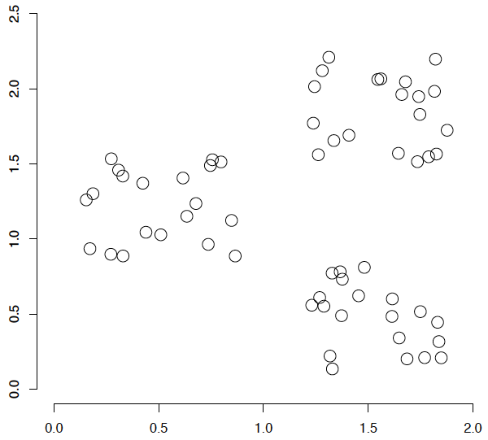
A data set with clear cluster structure
Ch. 16
How would you design an algorithm for finding the three clusters in this case?

Slide 23
Applications of clustering in IR
Sec. 16.1
Whole corpus analysis/navigation
Better user interface: search without typing
For improving recall in search applications
Better search results (like pseudo RF)
For better navigation of search results
Effective “user recall” will be higher
For speeding up vector space retrieval
Cluster-based retrieval gives faster search

Slide 24
Yahoo! Hierarchy isn’t clustering but is the kind of output you want from clustering
www.yahoo.com/Science
… (30)
agriculture
biology
physics
CS
space
...
...
...
...
...
dairy
crops
botany
cell
AI
courses
craft
magnetism
HCI
missions
forestry
agronomy
evolution
relativity
Notes:
Final data set:
Yahoo Science hierarchy, consisting of text of web pages pointed to by Yahoo, gathered summer of 1997.
264 classes, only sample shown here.

Slide 25
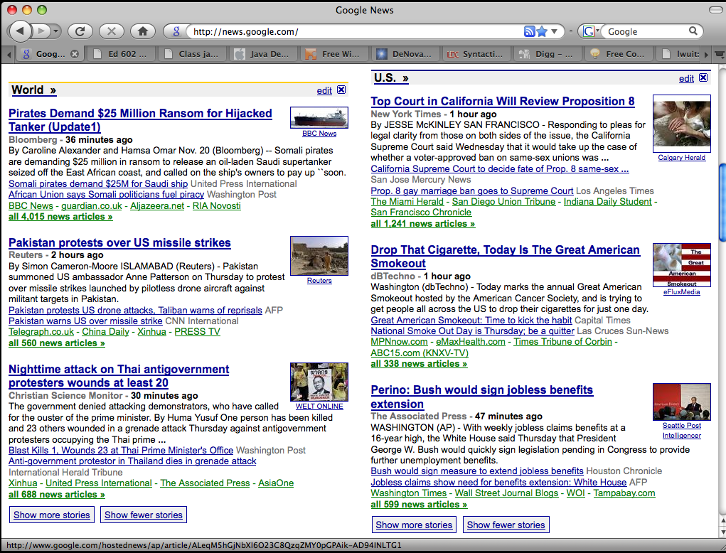
Google News: automatic clustering gives an effective news presentation metaphor

Slide 26
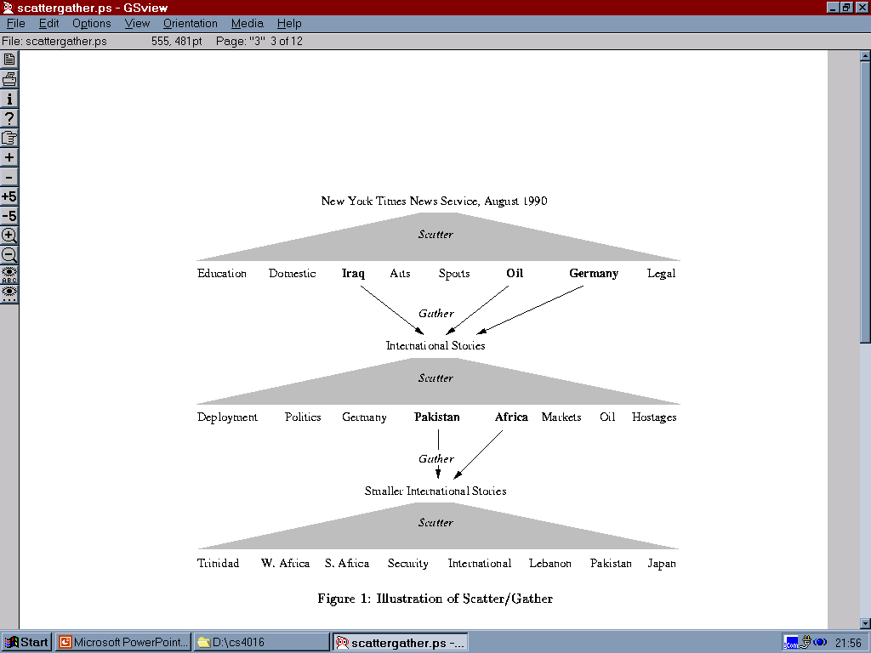
Scatter/Gather: Cutting, Karger, and Pedersen
Sec. 16.1

Slide 27
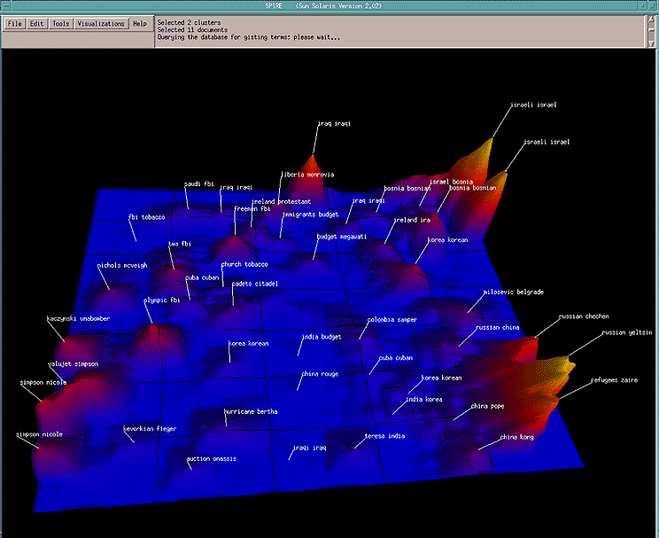
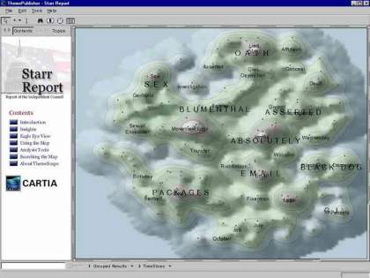
For visualizing a document collection and its themes
Wise et al, “Visualizing the non-visual” PNNL
ThemeScapes, Cartia
[Mountain height = cluster size]

Slide 28
For improving search recall
Sec. 16.1
Cluster hypothesis - Documents in the same cluster behave similarly with respect to relevance to information needs
Therefore, to improve search recall:
Cluster docs in corpus a priori
When a query matches a doc D, also return other docs in the cluster containing D
Hope if we do this: The query “car” will also return docs containing automobile
Because clustering grouped together docs containing car with those containing automobile.
Why might this happen?

Slide 29
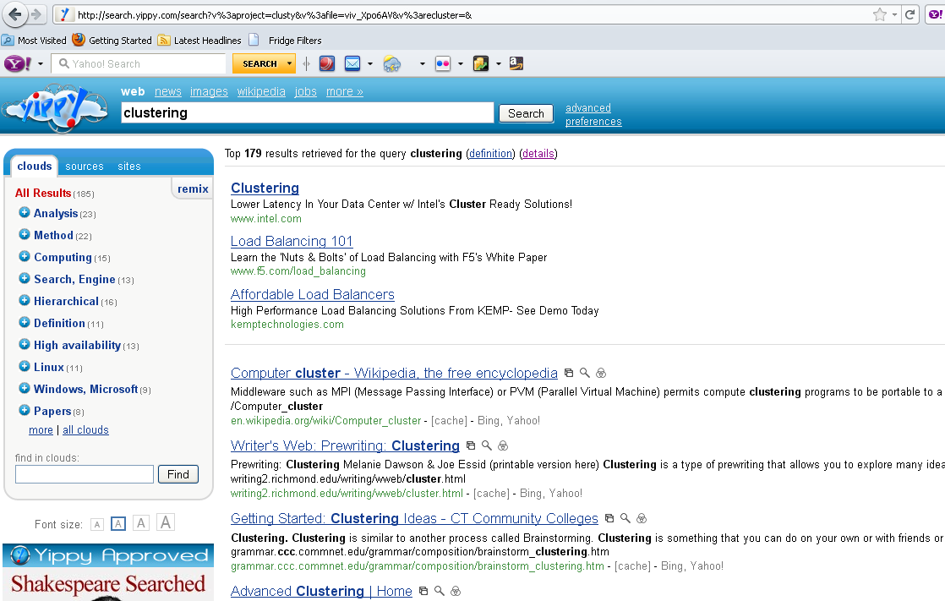
yippy.com – grouping search results

Slide 30
Issues for clustering
Sec. 16.2
Representation for clustering
Document representation
Vector space? Normalization?
Centroids aren’t length normalized
Need a notion of similarity/distance
How many clusters?
Fixed a priori?
Completely data driven?
Avoid “trivial” clusters - too large or small
If a cluster's too large, then for navigation purposes you've wasted an extra user click without whittling down the set of documents much.

Slide 31
Notion of similarity/distance
Ideal: semantic similarity.
Practical: term-statistical similarity
We will use cosine similarity.
Docs as vectors.
For many algorithms, easier to think in terms of a distance (rather than similarity) between docs.
We will mostly speak of Euclidean distance
But real implementations use cosine similarity

Slide 32
Clustering Algorithms
Flat algorithms
Usually start with a random (partial) partitioning
Refine it iteratively
K means clustering
(Model based clustering)
Hierarchical algorithms
Bottom-up, agglomerative
(Top-down, divisive)

Slide 33
References
Enterprise Architecture at Work Modelling, Communication and Analysis,: Lankhorst, Marc
How to Survive in the Jungle of Enterprise Architecture Frameworks: Creating or Choosing an Enterprise Architecture Framework, Jaap Schekkerman
An Introduction to Enterprise Architecture: Third Edition, Scott A. Bernard, AuthorHouse

